Slide 1

SFF S3 - APIs
Ruben Martínez & Marc Compta

Slide 2
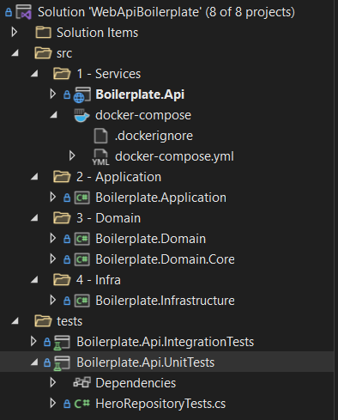
API .NET (C#) – Basic Structure
.NET 6 Boilerplate:
https://github.com/yanpitangui/dotnet-api-boilerplate
Solution (.sln) vs Project (.csproj): . A solution is a container for projects, and tracks dependencies between projects.

Slide 3
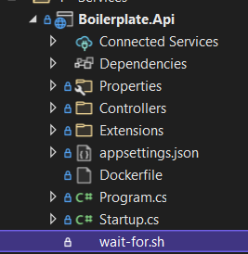
Boilerplate.Api
Appsettings.json: Allows us to keep code separated from configuration (environment-dependant) (1).
Program.cs: the entry point for the application.
Startup.cs: it will be called after Program.cs file is executed at application level. It handles the request pipeline. Startup class triggers the second the application launches.
(1) https://12factor.net/config

Slide 4
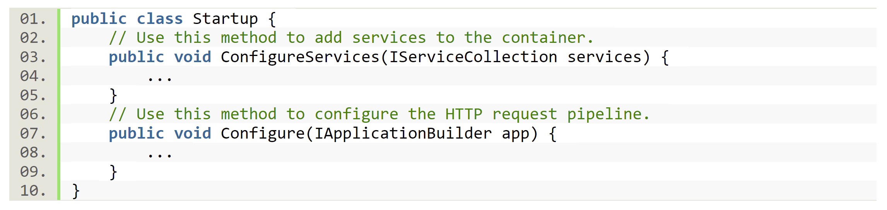
Startup.cs
Once we add some service in ConfigureService method, it Will be available to Configure method to be used.
SOURCE: https://www.c-sharpcorner.com/article/what-is-startup-class-and-program-cs-in-asp-net-core/

Slide 5
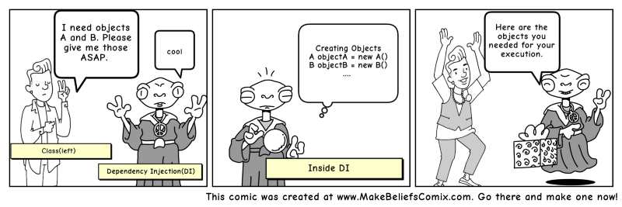
ConfigureServices & Dependency Injection
Add {…}
Transient: transient objects are always different; a new instance is provided to every controller and every service.
Scoped: scoped objects are the same within a request, but different across different requests.
Singleton: singleton objects are the same for every object and every request.
SOURCE: https://www.c-sharpcorner.com/article/what-is-startup-class-and-program-cs-in-asp-net-core
https://www.freecodecamp.org/news/a-quick-intro-to-dependency-injection-what-it-is-and-when-to-use-it-7578c84fa88f

Slide 6
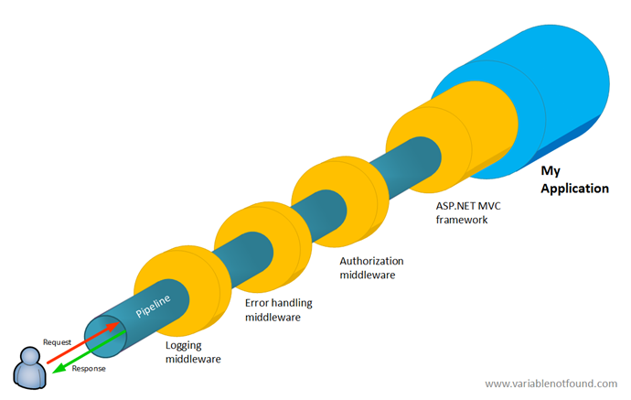
Configure and the Request Pipeline
- Middleware is a new concept introduced with Asp.net Core.
Can be configured using:
Run: short-circuit the pipeline
Use: transfers http request to next invoker
Map: accepts a path and a function that configures a separate middleware pipeline

Slide 7
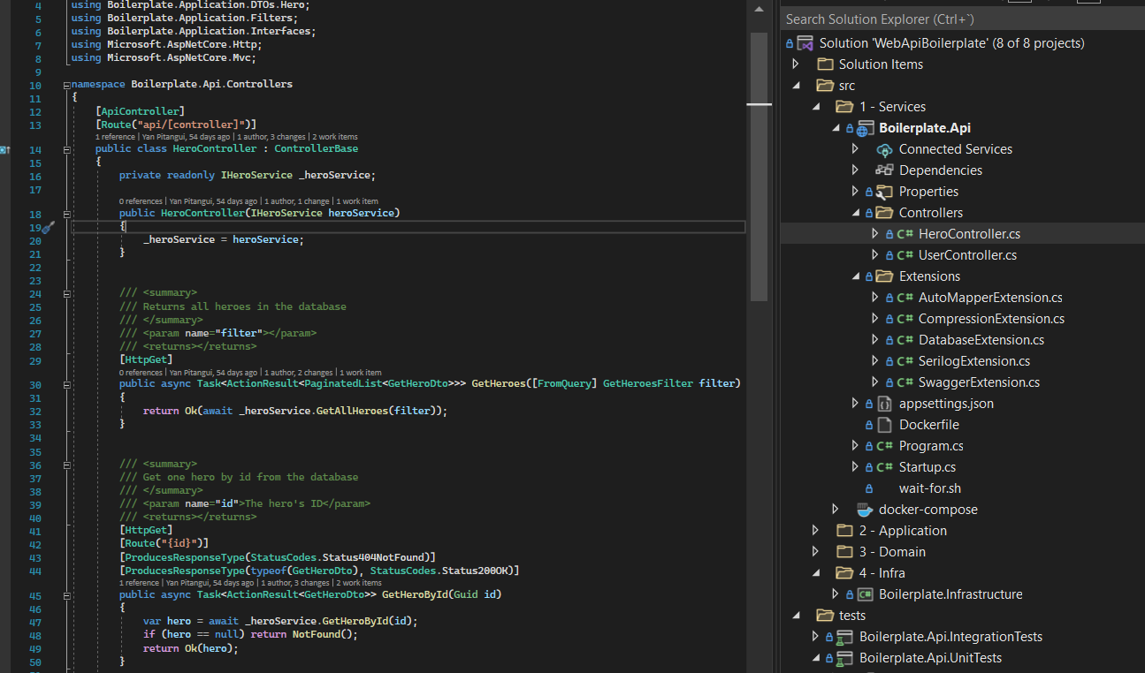
Controllers
Controller’s responsibility is to handle the HTTP request within the application’s scope.

Slide 8
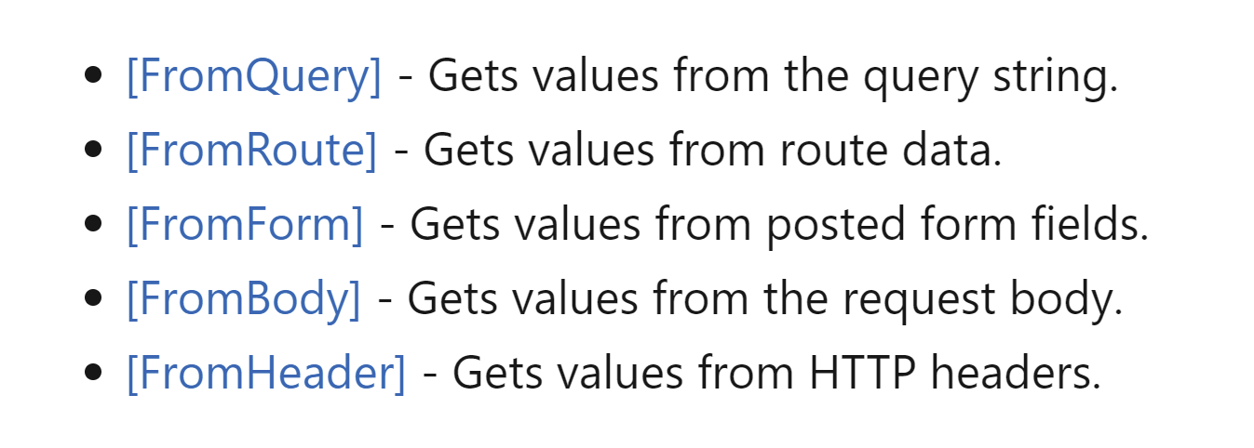
Model binders
SOURCE: https://docs.microsoft.com/en-us/aspnet/core/mvc/models/model-binding?view=aspnetcore-6.0

Slide 9
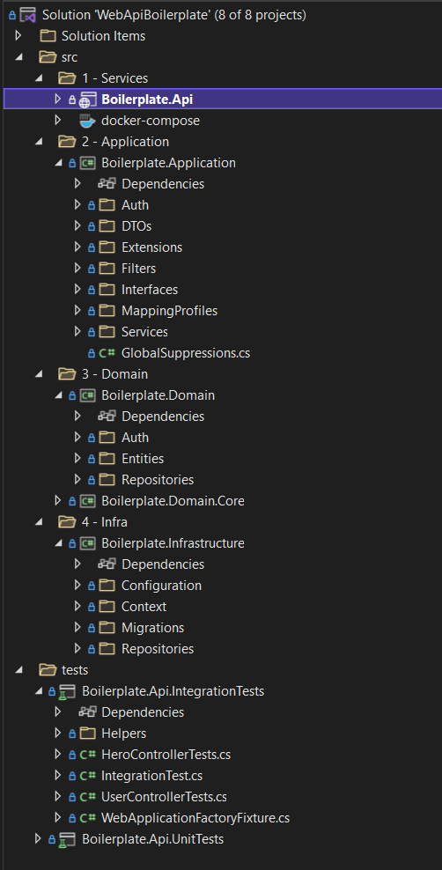
Solution structure
Application layer: It is the layer where business process flows are handled. The capabilities of the application can be observed in this layer. Domain entities are created and subject to update here. Depending on the usage scenarios, topics such as transaction management are also resolved here. In this layer, execution of work commands and reactions to domain events are coded.
Domain layer: This will be the core of the application. It is the layer where all business rules related to the problem to be solved are included. In this layer; entities, value objects, aggregates, factories and interfaces will take place. This layer should be kept away from dependencies as much as possible. Third party libraries should not be added as much as possible, as it should not take other layers as a reference.
Infrastructure layer: This layer will be the layer that accesses external services such as database, messaging systems and email services.
SOURCE: https://ademcatamak.medium.com/layers-in-ddd-projects-bd492aa2b8aa

